Slide 1

SQL CASE STUDY ON

Slide 2
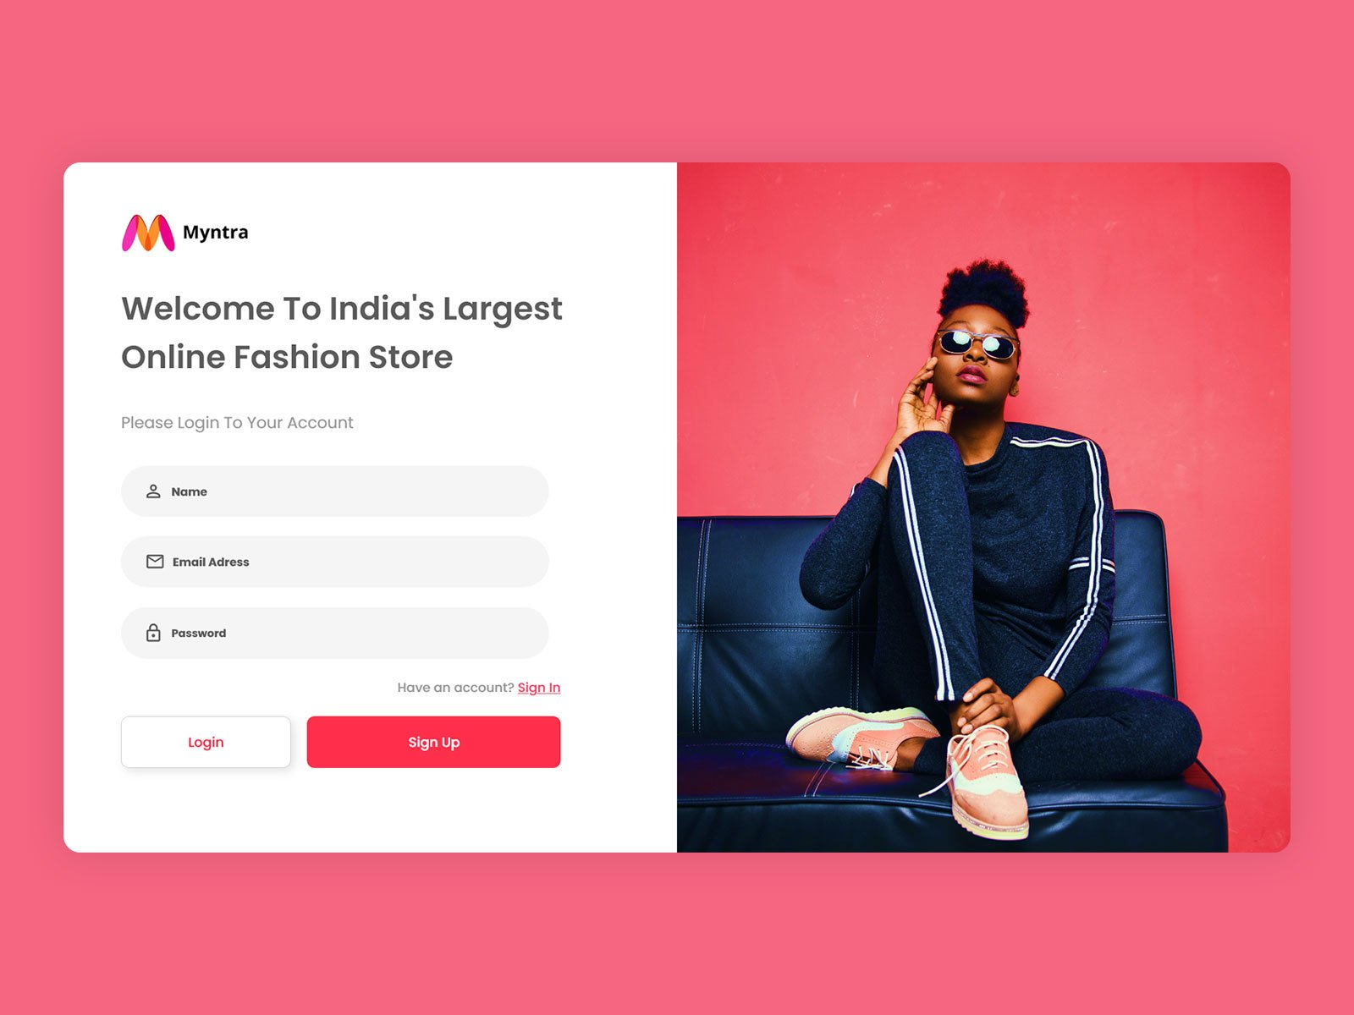
Sign up page :
Query:- Insert into users(name , email , password) values(‘Pratik’,’ pratikj@gmail.com’,’pratik1234’);

Slide 3

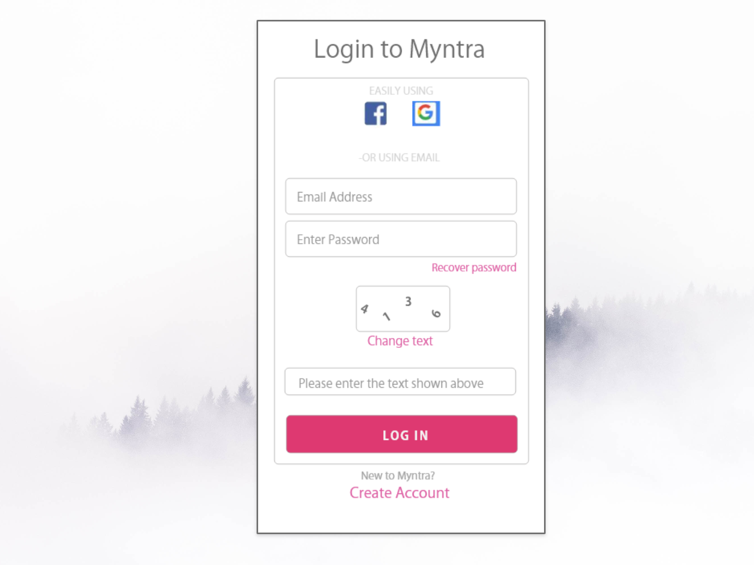

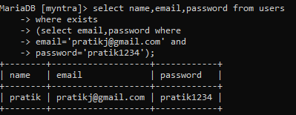

Login page
User table
If user exists :
If user not exists :
Exists statement’s

Slide 4
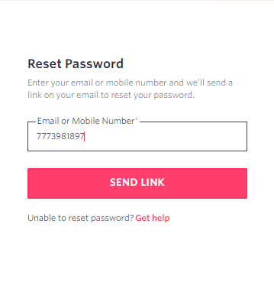
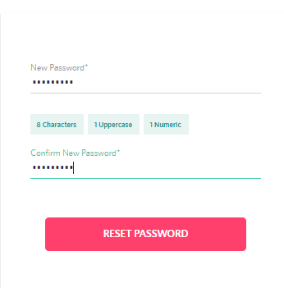

Reset password page :
Query : Update users set password='pratik123' where ph_no='7773981897';

Slide 5

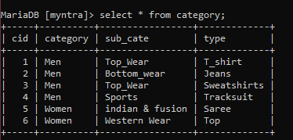
Tables :
Category table :
Products table :

Slide 6
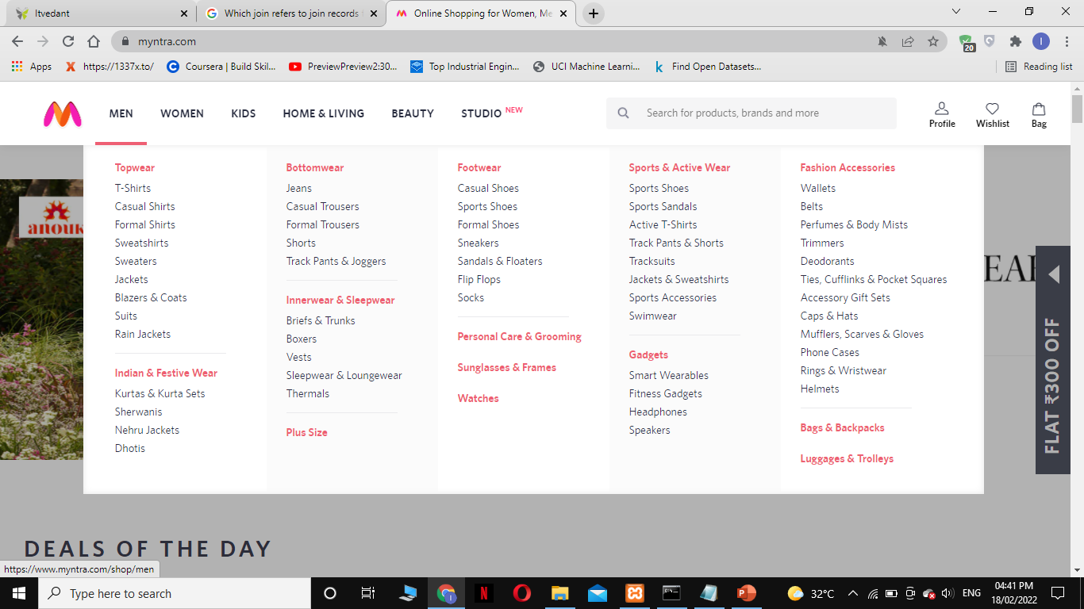
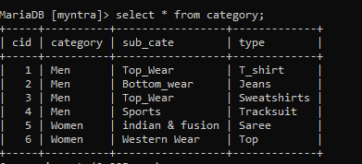
Category table :

Slide 7
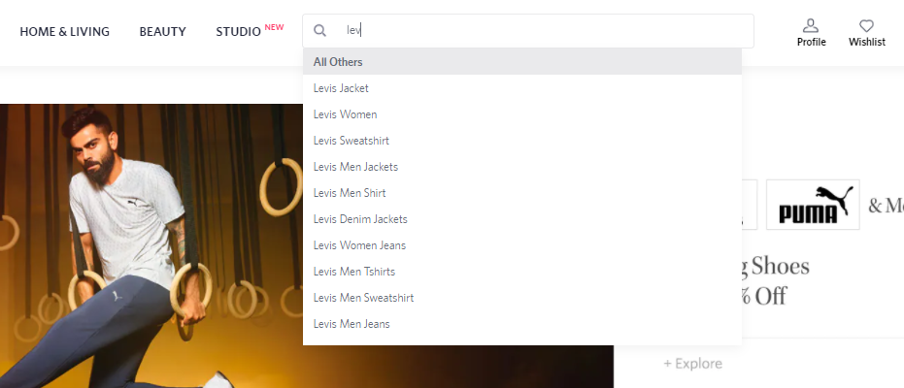

Search bar :
Like operator :

Slide 8
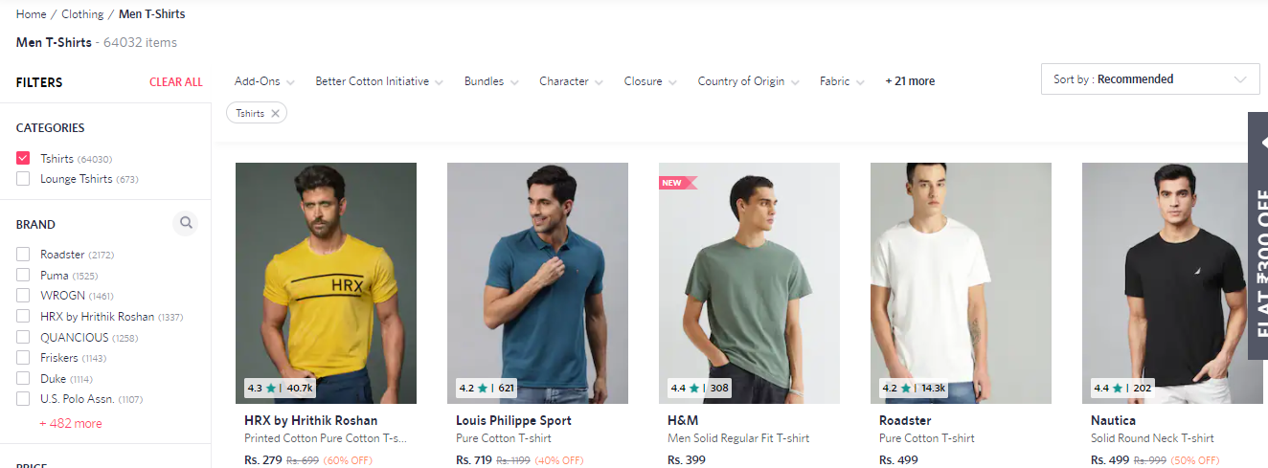

Filter by using men and t-shirt :

Slide 9
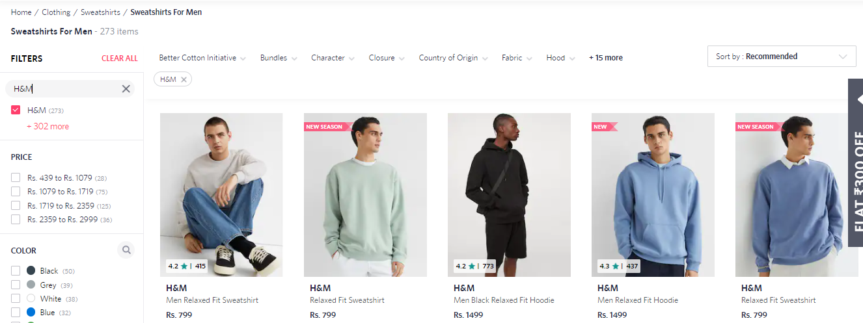

Filter by using brands :

Slide 10


Filter by using price range :
By using in between operation.

Slide 11
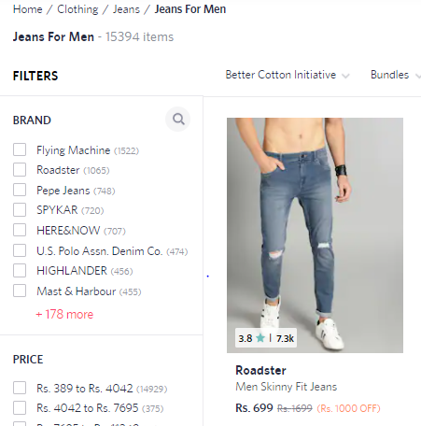

Total number of products :
Query by using inner join, where clause and group by :

Slide 12
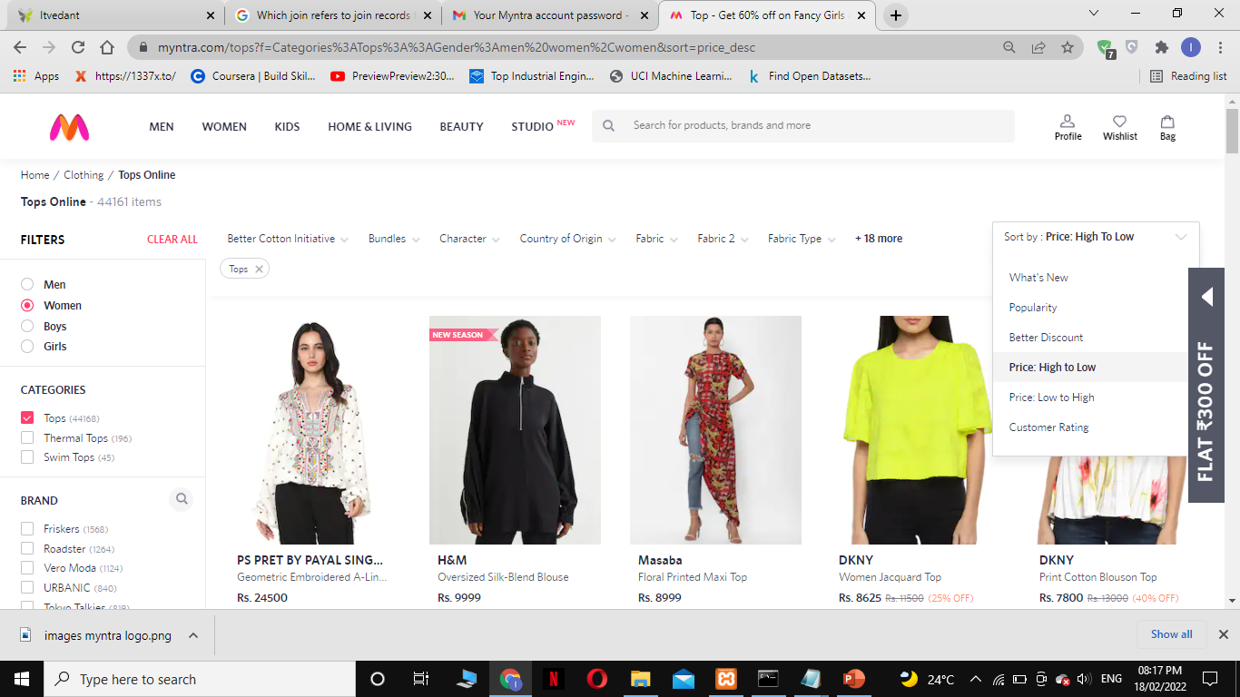

Filter by category , type and by price high to low by using order by query :

Slide 13

Kart table:

Slide 14
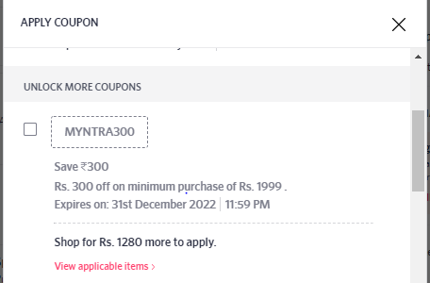
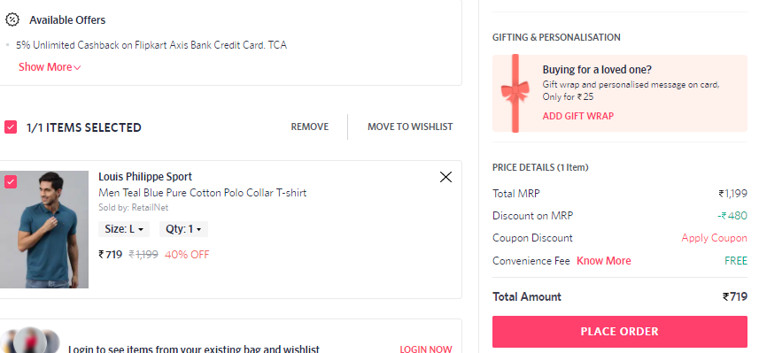

Order table : by using complex view of kart, products, users and category tables.
Case statements :

Slide 15
Thankyou.
Pratik Jadhav

